Slide 2
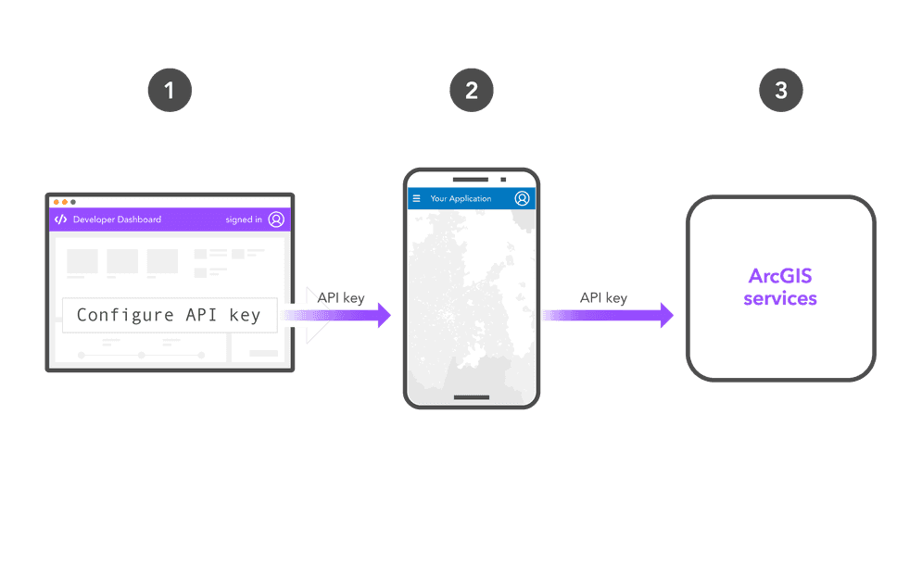
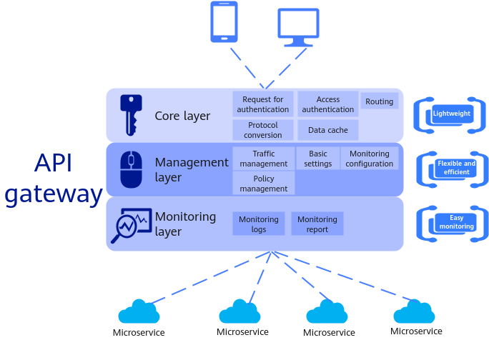

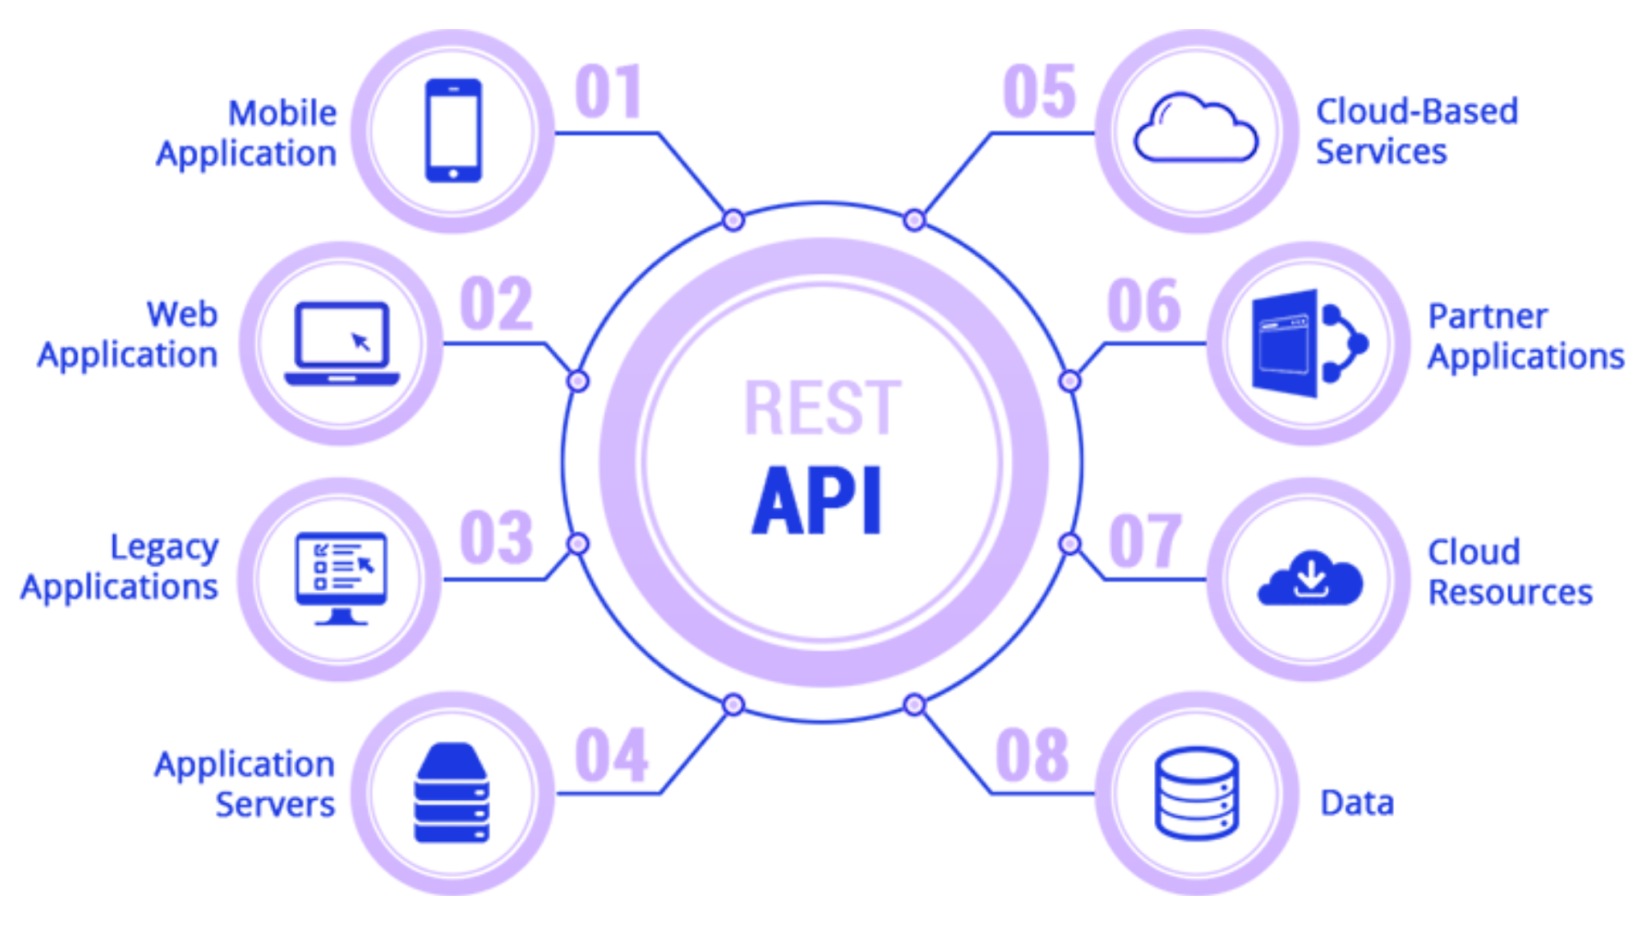
01
03
04
02
1
A.P.I
Lorem inesldfncjkws dkjc
Lorem inesldfncjkws dkjc
Lorem inesldfncjkws dkjc
Suebvkdnkjvner ksjdnzvk nwrsdlknxzcvkl wmdslkxzmv klwmdsklxzvm klwedsnxzklcvne dklsxnvkl ewndsklxzvn jklewsdnxzjklv nwdjksxznv jkw dsjkxzvn jkrwdsnxzjkvl nwkldsxzncvkl wnedsklxzv nwdskxznv klds
Suebvkdnkjvner ksjdnzvk nwrsdlknxzcvkl wmdslkxzmv klwmdsklxzvm klwedsnxzklcvne dklsxnvkl ewndsklxzvn jklewsdnxzjklv nwdjksxznv jkw dsjkxzvn jkrwdsnxzjkvl nwkldsxzncvkl wnedsklxzv nwdskxznv klds
2
Suebvkdnkjvner ksjdnzvk nwrsdlknxzcvkl wmdslkxzmv klwmdsklxzvm klwedsnxzklcvne dklsxnvkl ewndsklxzvn jklewsdnxzjklv nwdjksxznv jkw dsjkxzvn jkrwdsnxzjkvl nwkldsxzncvkl wnedsklxzv nwdskxznv klds
Suebvkdnkjvner ksjdnzvk nwrsdlknxzcvkl wmdslkxzmv klwmdsklxzvm klwedsnxzklcvne dklsxnvkl ewndsklxzvn jklewsdnxzjklv nwdjksxznv jkw dsjkxzvn jkrwdsnxzjkvl nwkldsxzncvkl wnedsklxzv nwdskxznv klds
Application Programming Interface
3
4
By Melvin Berkoh

Slide 3
04
01
03
02
1
Understanding APIs: An Introduction
Lorem inesldfncjkws dkjc
A.P.I
Lorem inesldfncjkws dkjc
Suebvkdnkjvner ksjdnzvk nwrsdlknxzcvkl wmdslkxzmv klwmdsklxzvm klwedsnxzklcvne dklsxnvkl ewndsklxzvn jklewsdnxzjklv nwdjksxznv jkw dsjkxzvn jkrwdsnxzjkvl nwkldsxzncvkl wnedsklxzv nwdskxznv klds
Suebvkdnkjvner ksjdnzvk nwrsdlknxzcvkl wmdslkxzmv klwmdsklxzvm klwedsnxzklcvne dklsxnvkl ewndsklxzvn jklewsdnxzjklv nwdjksxznv jkw dsjkxzvn jkrwdsnxzjkvl nwkldsxzncvkl wnedsklxzv nwdskxznv klds
2
Suebvkdnkjvner ksjdnzvk nwrsdlknxzcvkl wmdslkxzmv klwmdsklxzvm klwedsnxzklcvne dklsxnvkl ewndsklxzvn jklewsdnxzjklv nwdjksxznv jkw dsjkxzvn jkrwdsnxzjkvl nwkldsxzncvkl wnedsklxzv nwdskxznv klds
Suebvkdnkjvner ksjdnzvk nwrsdlknxzcvkl wmdslkxzmv klwmdsklxzvm klwedsnxzklcvne dklsxnvkl ewndsklxzvn jklewsdnxzjklv nwdjksxznv jkw dsjkxzvn jkrwdsnxzjkvl nwkldsxzncvkl wnedsklxzv nwdskxznv klds
Application Programming Interface
3
4

Slide 4
03
01
04
02
1
How APIs Work
A.P.I
Lorem inesldfncjkws dkjc
Lorem inesldfncjkws dkjc
Suebvkdnkjvner ksjdnzvk nwrsdlknxzcvkl wmdslkxzmv klwmdsklxzvm klwedsnxzklcvne dklsxnvkl ewndsklxzvn jklewsdnxzjklv nwdjksxznv jkw dsjkxzvn jkrwdsnxzjkvl nwkldsxzncvkl wnedsklxzv nwdskxznv klds
Suebvkdnkjvner ksjdnzvk nwrsdlknxzcvkl wmdslkxzmv klwmdsklxzvm klwedsnxzklcvne dklsxnvkl ewndsklxzvn jklewsdnxzjklv nwdjksxznv jkw dsjkxzvn jkrwdsnxzjkvl nwkldsxzncvkl wnedsklxzv nwdskxznv klds
2
Suebvkdnkjvner ksjdnzvk nwrsdlknxzcvkl wmdslkxzmv klwmdsklxzvm klwedsnxzklcvne dklsxnvkl ewndsklxzvn jklewsdnxzjklv nwdjksxznv jkw dsjkxzvn jkrwdsnxzjkvl nwkldsxzncvkl wnedsklxzv nwdskxznv klds
Suebvkdnkjvner ksjdnzvk nwrsdlknxzcvkl wmdslkxzmv klwmdsklxzvm klwedsnxzklcvne dklsxnvkl ewndsklxzvn jklewsdnxzjklv nwdjksxznv jkw dsjkxzvn jkrwdsnxzjkvl nwkldsxzncvkl wnedsklxzv nwdskxznv klds
Application Programming Interface
3
4

Slide 5
02
03
01
04
1
Lorem inesldfncjkws dkjc
A.P.I
Benefits and Application
Lorem inesldfncjkws dkjc
Types of APIs
Suebvkdnkjvner ksjdnzvk nwrsdlknxzcvkl wmdslkxzmv klwmdsklxzvm klwedsnxzklcvne dklsxnvkl ewndsklxzvn jklewsdnxzjklv nwdjksxznv jkw dsjkxzvn jkrwdsnxzjkvl nwkldsxzncvkl wnedsklxzv nwdskxznv klds
Suebvkdnkjvner ksjdnzvk nwrsdlknxzcvkl wmdslkxzmv klwmdsklxzvm klwedsnxzklcvne dklsxnvkl ewndsklxzvn jklewsdnxzjklv nwdjksxznv jkw dsjkxzvn jkrwdsnxzjkvl nwkldsxzncvkl wnedsklxzv nwdskxznv klds
Suebvkdnkjvner ksjdnzvk nwrsdlknxzcvkl wmdslkxzmv klwmdsklxzvm klwedsnxzklcvne dklsxnvkl ewndsklxzvn jklewsdnxzjklv nwdjksxznv jkw dsjkxzvn jkrwdsnxzjkvl nwkldsxzncvkl wnedsklxzv nwdskxznv klds
2
Suebvkdnkjvner ksjdnzvk nwrsdlknxzcvkl wmdslkxzmv klwmdsklxzvm klwedsnxzklcvne dklsxnvkl ewndsklxzvn jklewsdnxzjklv nwdjksxznv jkw dsjkxzvn jkrwdsnxzjkvl nwkldsxzncvkl wnedsklxzv nwdskxznv klds
Application Programming Interface
3
4

Slide 6
01
03
04
02
1
Lorem inesldfncjkws dkjc
A.P.I
Benefits and Application
Lorem inesldfncjkws dkjc
Suebvkdnkjvner ksjdnzvk nwrsdlknxzcvkl wmdslkxzmv klwmdsklxzvm klwedsnxzklcvne dklsxnvkl ewndsklxzvn jklewsdnxzjklv nwdjksxznv jkw dsjkxzvn jkrwdsnxzjkvl nwkldsxzncvkl wnedsklxzv nwdskxznv klds
Suebvkdnkjvner ksjdnzvk nwrsdlknxzcvkl wmdslkxzmv klwmdsklxzvm klwedsnxzklcvne dklsxnvkl ewndsklxzvn jklewsdnxzjklv nwdjksxznv jkw dsjkxzvn jkrwdsnxzjkvl nwkldsxzncvkl wnedsklxzv nwdskxznv klds
Suebvkdnkjvner ksjdnzvk nwrsdlknxzcvkl wmdslkxzmv klwmdsklxzvm klwedsnxzklcvne dklsxnvkl ewndsklxzvn jklewsdnxzjklv nwdjksxznv jkw dsjkxzvn jkrwdsnxzjkvl nwkldsxzncvkl wnedsklxzv nwdskxznv klds
2
Suebvkdnkjvner ksjdnzvk nwrsdlknxzcvkl wmdslkxzmv klwmdsklxzvm klwedsnxzklcvne dklsxnvkl ewndsklxzvn jklewsdnxzjklv nwdjksxznv jkw dsjkxzvn jkrwdsnxzjkvl nwkldsxzncvkl wnedsklxzv nwdskxznv klds
Application Programming Interface
3
4

Slide 7
04
Lorem inesldfncjkws dkjc
Suebvkdnkjvner ksjdnzvk nwrsdlknxzcvkl wmdslkxzmv klwmdsklxzvm klwedsnxzklcvne dklsxnvkl ewndsklxzvn jklewsdnxzjklv nwdjksxznv jkw dsjkxzvn jkrwdsnxzjkvl nwkldsxzncvkl wnedsklxzv nwdskxznv klds
4

Slide 8
03
Lorem inesldfncjkws dkjc
Suebvkdnkjvner ksjdnzvk nwrsdlknxzcvkl wmdslkxzmv klwmdsklxzvm klwedsnxzklcvne dklsxnvkl ewndsklxzvn jklewsdnxzjklv nwdjksxznv jkw dsjkxzvn jkrwdsnxzjkvl nwkldsxzncvkl wnedsklxzv nwdskxznv klds
3

Slide 9
02
Lorem inesldfncjkws dkjc
Suebvkdnkjvner ksjdnzvk nwrsdlknxzcvkl wmdslkxzmv klwmdsklxzvm klwedsnxzklcvne dklsxnvkl ewndsklxzvn jklewsdnxzjklv nwdjksxznv jkw dsjkxzvn jkrwdsnxzjkvl nwkldsxzncvkl wnedsklxzv nwdskxznv klds
2

Slide 10
01
1
Lorem inesldfncjkws dkjc
Suebvkdnkjvner ksjdnzvk nwrsdlknxzcvkl wmdslkxzmv klwmdsklxzvm klwedsnxzklcvne dklsxnvkl ewndsklxzvn jklewsdnxzjklv nwdjksxznv jkw dsjkxzvn jkrwdsnxzjkvl nwkldsxzncvkl wnedsklxzv nwdskxznv klds

